Slide 1
Billing and Coding Tips
Sophie Lu, MN, PPCNP-BC, ARNP
UW Center on Human Development and Disability (CHDD)
WA State Medical Home Partnerships Project (MHPP) UW Leadership Education in Neurodevelopmental and Related Disabilities (LEND)

Slide 2
Bill by Time - E/M CPT Codes
All time billed must be on the same date as billable encounter
Start with meeting the highest level of service (99205 or 99215)
Then add prolonged service codes: G2212 (Medicaid) and 99417 (private insurance)
1 unit of G2212 or 99417 = 15 minute increment
Notes:
Bill by time - ASD evaluations are more time intensive than the standard primary care visit
G2212 requires the max time (74 min or 54 min) plus 15 minutes
99417 minimum time (60 or 40 min) plus 15 minutes

Slide 3
What can you count?
Total time spent on patient care (face-to-face and non-face-to-face time personally provided by billable provider) can be counted including:
preparing to see the patient (e.g. review of testing records)
performing a medically appropriate examination and/or evaluation
counseling and educating the patient/family/caregiver
ordering medications, tests, or procedures
referring and communicating with other health care professionals (when not separately reported)
documenting clinical information in the electronic or other health record
independently interpreting results (not separately reported) and communicating results to the patient/family/caregiver
care coordination (not separately reported)

Slide 4
Upper limit
Notes:
Screenshot from HCA Physician-related services/health care billing guide

Slide 5
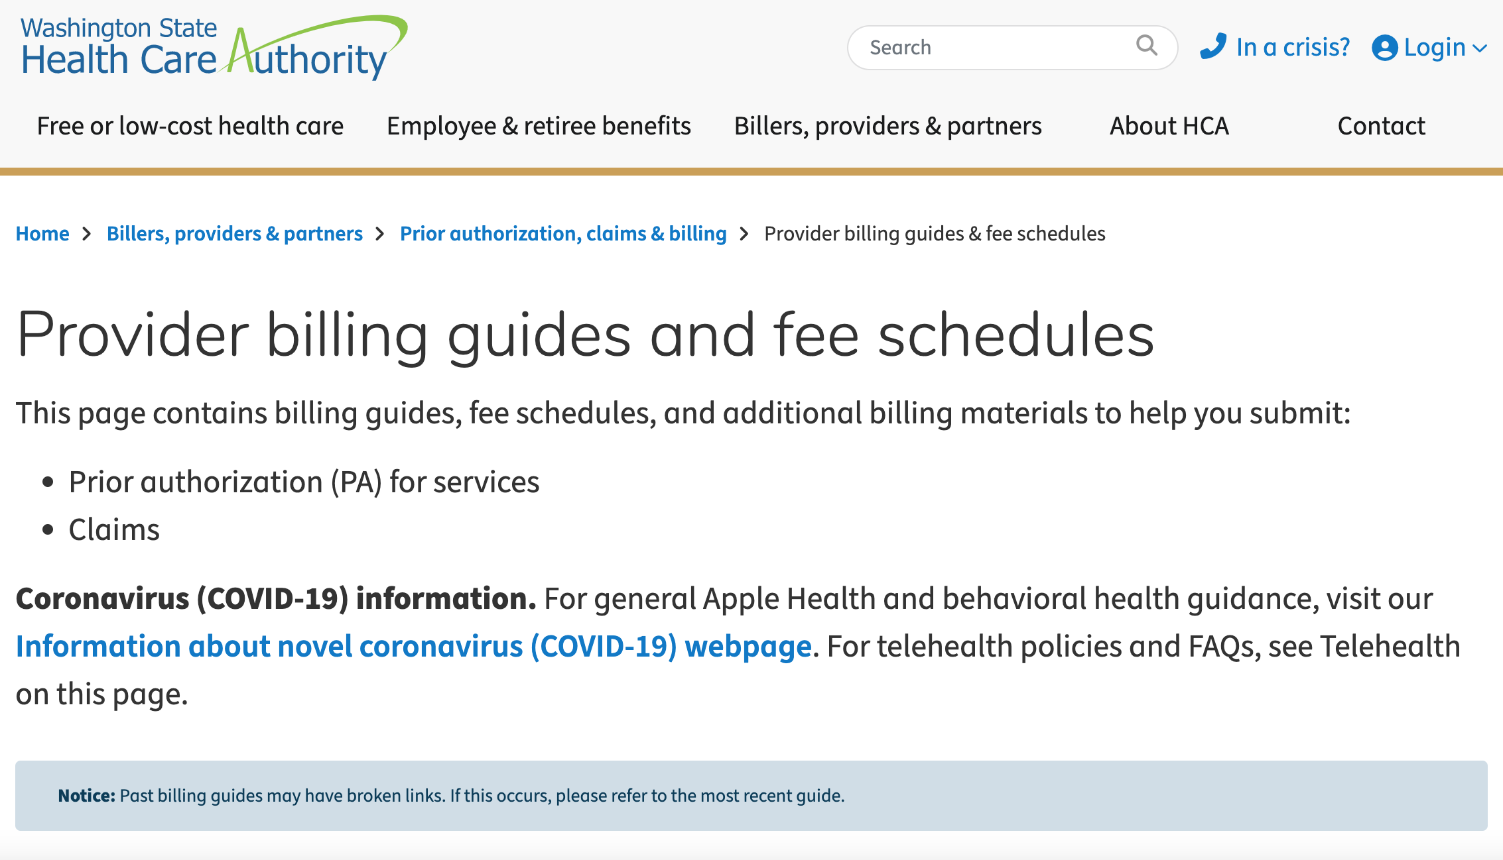
Notes:
https://www.hca.wa.gov/billers-providers-partners/prior-authorization-claims-and-billing/provider-billing-guides-and-fee-schedules

Slide 6
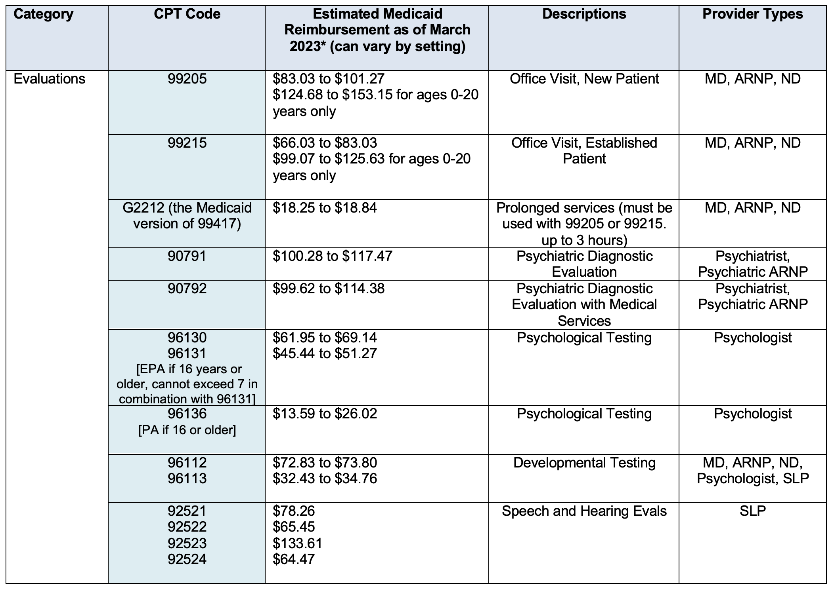

Slide 7
Making the financial case
Talking points when approaching your organization about COE ASD evaluations:
The time needed for ASD evaluations likely will mean a decrease in number of patients you see on those days.
The decrease in patient volume could potentially be partially offset by billing on time.
Ask for time set aside before the visit for reviewing records in preparation.
Ask for time set aside after the visit for documentation.
Break down the evaluation over 2-3 separate visits on different days.
Consider negotiating with MCOs on reimbursement rate.

Slide 8
Billing Resources
AMA Guideline
https://www.ama-assn.org/system/files/2019-06/cpt-office-prolonged-svs-code-changes.pdf
HCA Provider billing guides and fee schedules
https://www.hca.wa.gov/billers-providers-partners/prior-authorization-claims-and-billing/provider-billing-guides-and-fee-schedules

Slide 9
Questions?
Image Credit: ID 205147455 © Ricochet69 | Dreamstime.com

